Slide 1


Welcome To
www.globalbigdataconference.com
Twitter : @bigdataconf
#GlobalAI

Slide 2
Quality AI Requires Quality Data
Lower Risk, Improve Results, Avoid Disasters!
Edward Pollack
Microsoft Data Platform MVP

Slide 3
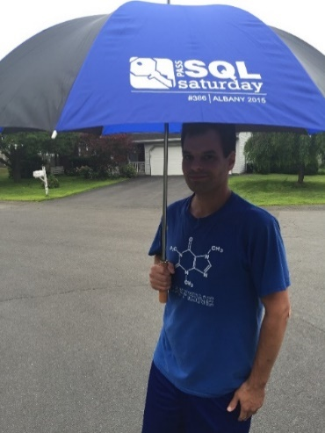






Ed Pollack
Microsoft Data Platform MVP
Published author of:
  Dynamic SQL: Applications, Performance, and Security, 2nd Edition
  Analytics Optimization with Columnstore Indexes in SQL Server
    2nd edition forthcoming in spring 2026.
  Expert Performance Indexing in SQL Server, 4th Edition
  Published in Expert T-SQL Functions in SQL Server, 3rd Edition
Author on Simple Talk.
Organizes:
  SQL Saturday Albany
  SQL Saturday New York City
  Capital Area SQL Server User Group
Speaker at many data events
Find me on: LinkedIn

Slide 4
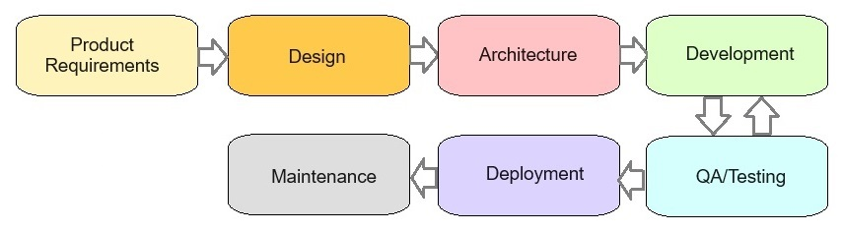
Software Development Life Cycle
(Sometimes)

Slide 5
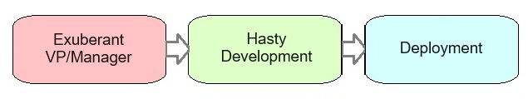
AI Development Life Cycle
(Sometimes)

Slide 6
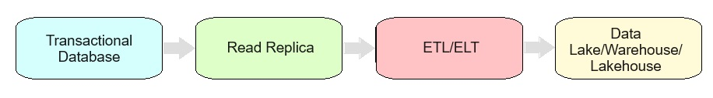
Challenges of Data & AI
Data grows and evolves over time
Data may be copied/moved/transformed many times prior to ML/AI
Existing data quality is inherited by downstream processes
AI processes are often quite authoritative

Slide 7
An Important Reminder!
AI Algorithms are software tools.
They are trained on, and act on data.
We are responsible for software that uses these algorithms!

Slide 8
How can we
prevent bad data?

Slide 9

OLTP/App/Edge Data: Data Starts Here!
This is bad application data!
Its data journey begins here.
Bad data from here will persist forever.

Slide 10
Validate OLTP/App/Edge Data
Application constraints/restrictions
Routine data validation processes
Unique indexes/constraints
Foreign keys/check constraints
Many of the above!

Slide 11
Validate ETL/ELT Data
Validate data during movement
Before vs. after testing
Metrics (Counts, min, max, sum, etc…)
Value-based validation
  Are values realistic/correct?

Slide 12
Validate OLAP/Report/Analytic Data
Validate data after movement:
  Data size (row count, byte count, etc…)
  Validate values (uniqueness, NULL? invalid values?)
  Missing data?
  Duplicate data?
  Edge-cases?
  Inconsistent values?
  Validate BEFORE training models/RAG!

Slide 13

Post-Release Validation
When code changes, validate impacted data
Back up any data-to-be-modified!
Without QA, existing data/validation may become incomplete/incorrect.

Slide 14
Names/Data Types Matter!
Poorly named data elements can trick AI (or us!) into making bad decisions.
Poorly typed data can confuse AI.
Is data excluded due to metadata values?
Check with original data source, if needed.
Integer named “Invoice”? What is it?
Datetime named “EntryTime”? Is it date/time or time?
Column named “IsDeleted”: Should AI use this data?

Slide 15
Note: Training Data vs. RAG Data
Both are important for a scalable AI application
Both can experience bad data
Bad training data = misbehaving model
Bad RAG data = incorrect responses

Slide 16
How do we
cheat bad data?

Slide 17
Prompt Engineering
Improves AI interactions and output
Delineates purpose
Ensures relevance
Refines inputs/outputs
Cannot prompt your way out of bad data!

Slide 18
RAG (Retrieval Augmented Generation)
This data used to provide meaningful output
Train model on one data set, use another data set for RAG.
Cannot “fix” bad training
Fixing/updating bad RAG data is not hard.

Slide 19

Fine-Tuning
Tailors model to a more specific use-case.
Adds specific domain-knowledge to data.
Required specific goals
Is NOT a solution to bad data.

Slide 20
More Data is Not Always Better!
Ensure data points are:
  Accurate
  Relevant
  Complete
Reduce Noise
Remove data that will lead to bad training or bad responses.

Slide 21
Synthetic Data
Artificially-generated data
Mimics real-world data
  Same mathematical properties
  Can replace PII/protected data
Hard to generate without bias/replication/bad data
Need to prove that new data is valid AND unique.
Validate: Does it add value to existing data?

Slide 22
Unlearning Data Can Harm Models
Unlearning involves forcing a model to forget specific information.
  PII
  Bad data
  Copyrighted material
Beware legal/compliance issues
Test carefully to ensure no adverse side-effects
Consider updating training data & retraining a model

Slide 23

Conclusion
Bad data is most easily resolved at its source.
Data quality rules have not changed over the years!
AI model manipulation is not a substitute for good data.
Carefully test models and ensure that invalid responses are identified and resolved by finding their origin.

Slide 24
Questions? Thank You!
Find me here:
Ed Pollack | LinkedIn
Edward Pollack | Most Valuable Professionals
https://sessionize.com/edward-pollack/
Find my content here:
EdwardPollack (Ed Pollack) (github.com)
Edward Pollack, Author at Simple Talk (red-gate.com)
Ed Pollack, Author at SQL Shack - articles about database auditing, server performance, data recovery, and more

